Slide 1
Name that moon phase

Slide 2
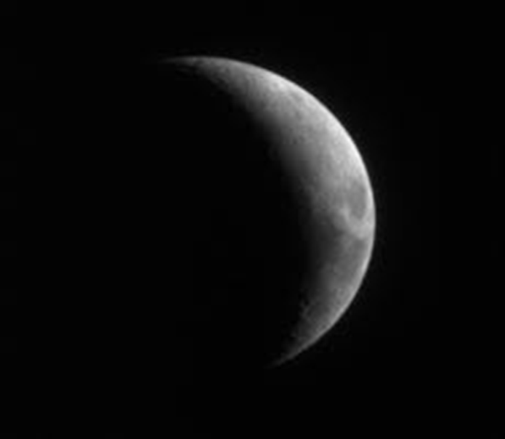
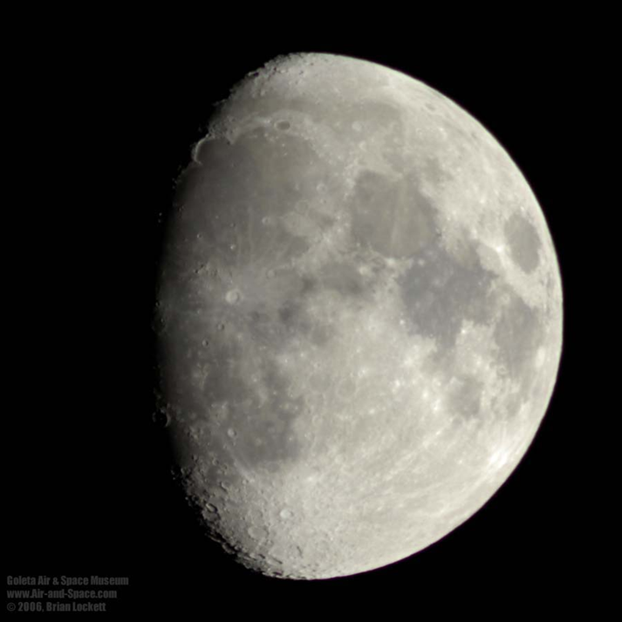
RIGHT
Which side of the moon appears when the moon is WAXING??

Slide 3
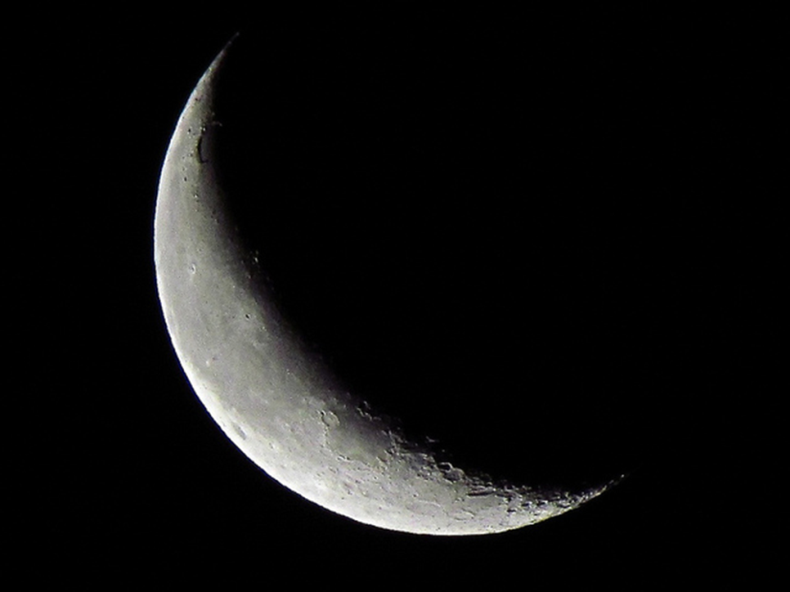
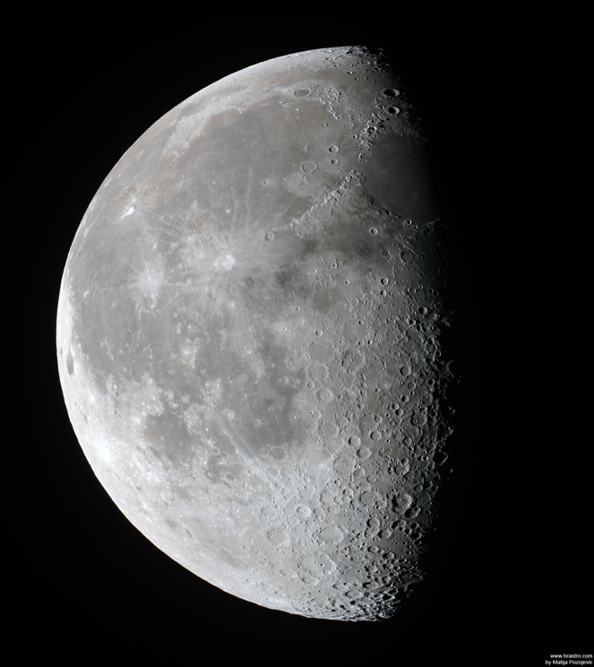
LEFT
Which side of the moon appears when it is WANING?

Slide 4
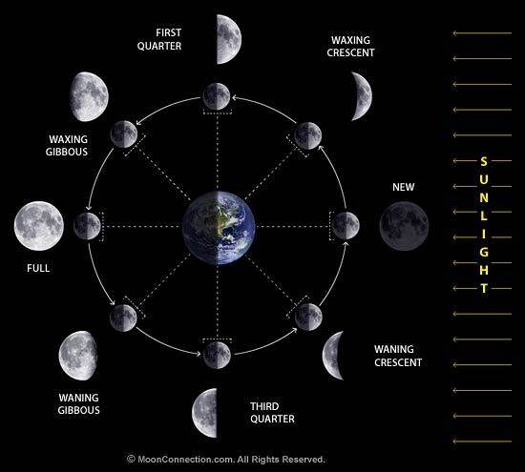
STUDY

Slide 5
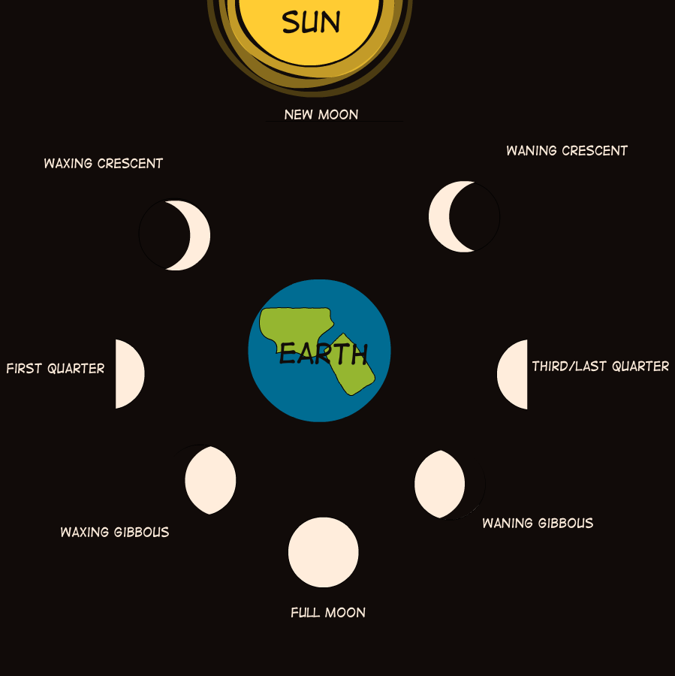

Slide 6
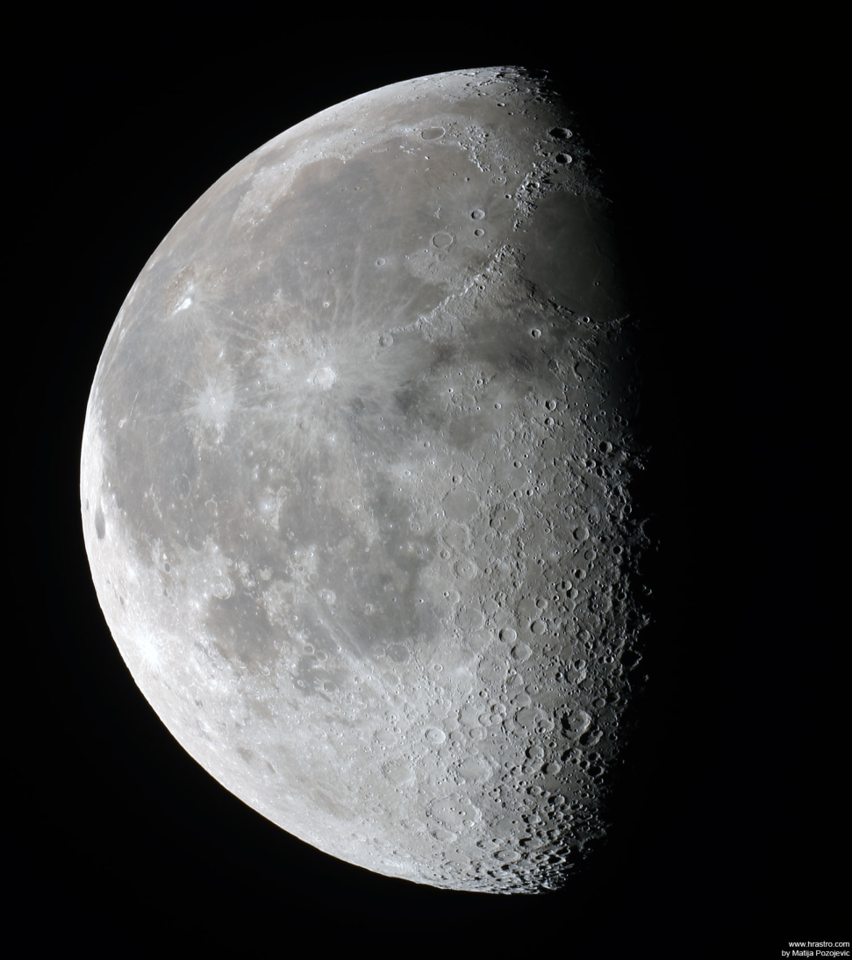
Waning Gibbous

Slide 7
Waxing Crescent

Slide 8
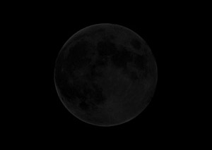
New Moon

Slide 9
Waxing Gibbous

Slide 10
Waning Crescent

Slide 11
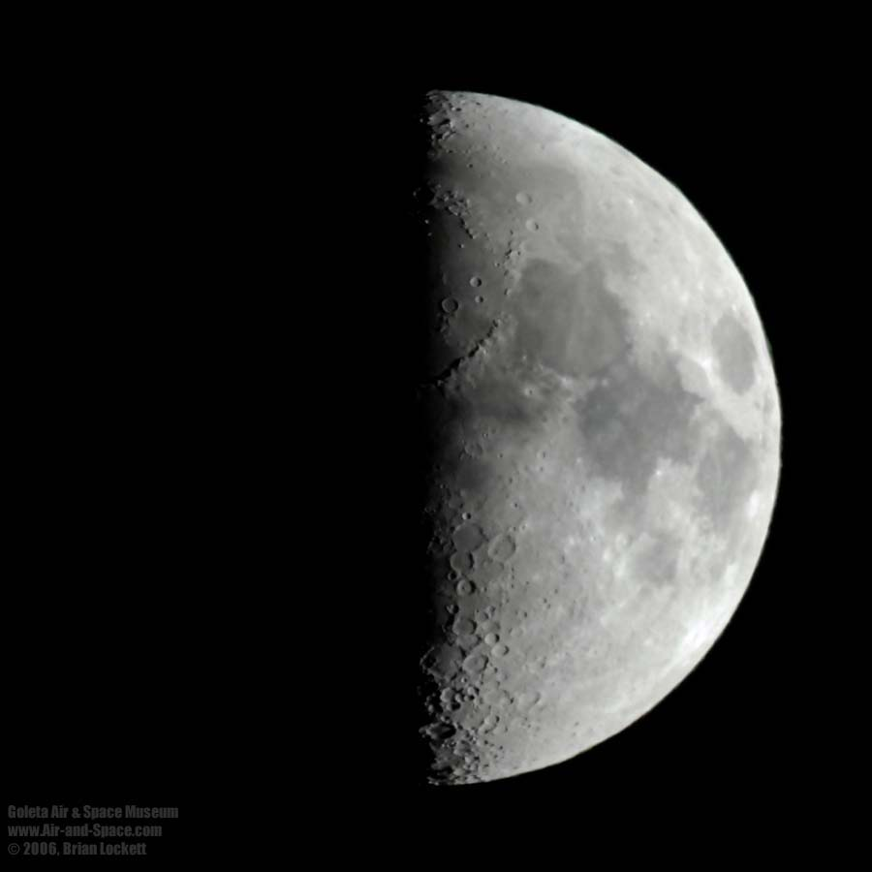
1st Quarter Moon-Half Moon

Slide 12
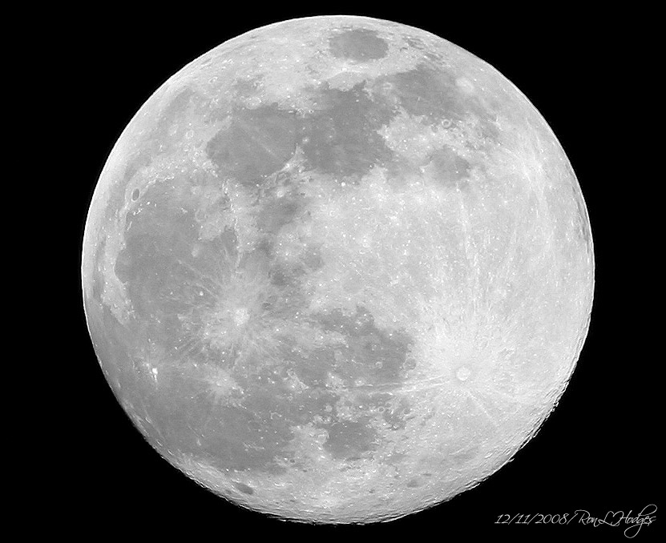
Full Moon

Slide 13
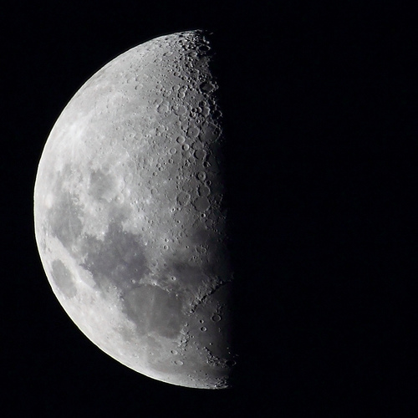
3rd Quarter Moon-Half Moon

Slide 14
RIGHT
Which side of the moon appears when the moon is WAXING??

Slide 15
LEFT
Which side of the moon appears when it is WANING?

Slide 16
Put them in order
Waning Gibbous
Waxing Crescent
New Moon
Waxing Gibbous
Waning Crescent
1st Qtr Moon
Full Moon
3rd Qtr Moon

Slide 17
Answer
New Moon
Waxing Crescent
Waxing Gibbous
1st Quarter Moon - Half
Full Moon
Waning Gibbous
3rd Quarter Moon - Half
Waning Crescent

Slide 18
You draw them!

